Slide 1
JD/MAPP
Joint Degree Academic Planning

Slide 2
MAPP Degree Requirements

Slide 3
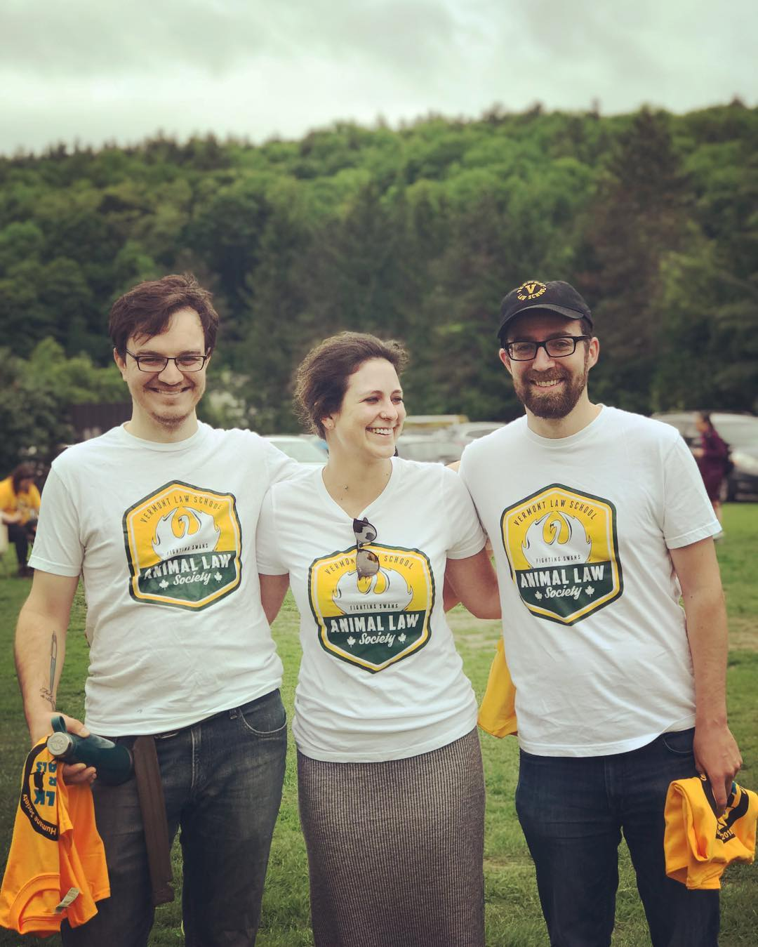
MAPP Credits
Minimum of 34 credits to earn the MAPP
22 MAPP-only credits (not shared with JD)
12 Shared Credits (shared with JD)
Grades in shared classes count toward both degrees
Credits for shared classes count toward both degrees
Only share fall or spring classes, not summer
Only share environmental classes (see Student Handbook for full list of courses)

Slide 4
MAPP Required Courses
Legislation & Regulation (3) – share this JD class
Intro to Policy Research & Writing – waived for JD students
Structural Inequality (1)
Animal Protection Policy (3)
Quantitative Analysis (2)
Science of Animal Law and Policy (2)
Animal Ethics (3)
Policy Design (3)

Slide 5
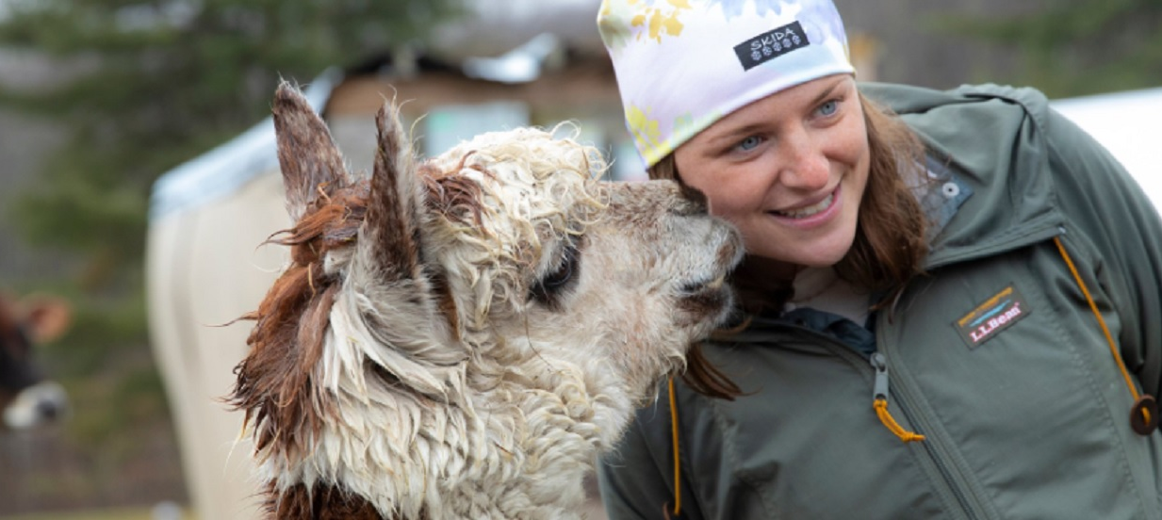
Non-credit Skills Modules
Understanding DEI
Professional Identity Formation
Public Participation
Negotiation & Consensus-Building

Slide 6
Waivers
Email Anne at alinehan@vermontlaw.edu to request a waiver
Tell her what class(es) you took in undergrad that might allow you to waive, and she will review your transcript to confirm
A waiver is zero credits; it just frees you up to take other classes

Slide 7
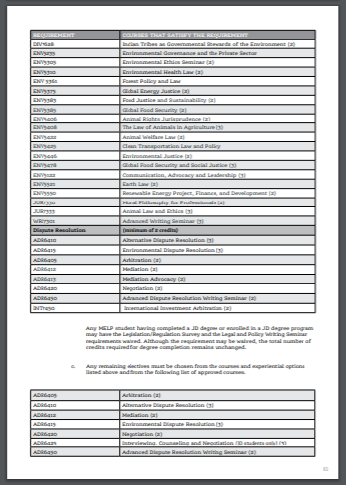
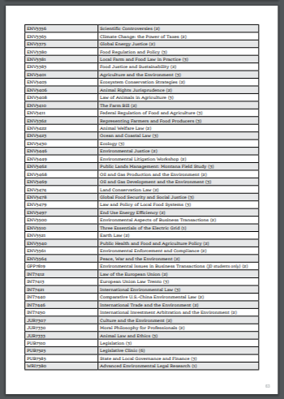
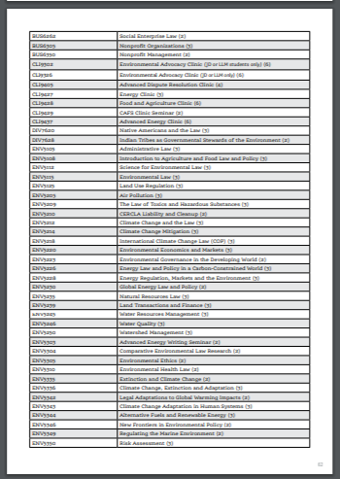
Electives
Any MAPP course that is not required or core just counts as an elective
Sampling of Animal Protection Courses:
Animals and the Law
Biodiversity Conservation
Climate Change, Extinction and Adaptation
Connected Justice: Animals, People and the Environment
Ocean and Coastal Law
The Law of Animals in Agriculture
Undercover Investigations of Animal Operations
Other Courses in the Law and Graduate Schools
Climate Change and the Environment
Environmental Justice
Food and Agriculture
Fundamentals and Skills
International Environment
Public Health
Sustainability and Business
Notes:
Nearly 100 courses available for the 9-12 credits. Can take animal protection courses or expand into other areas of the school.

Slide 8
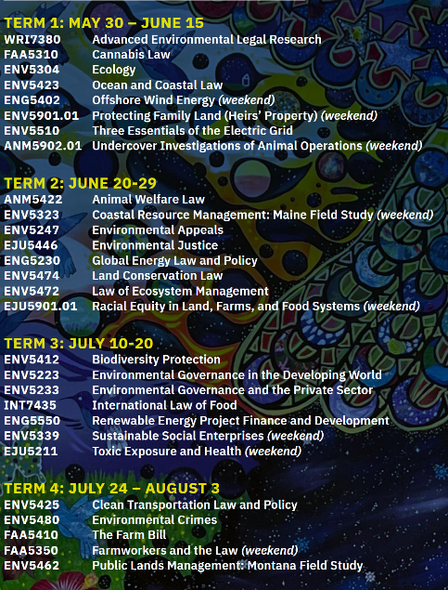
The Summer Schedule
Typically take one class in each term, plus one or more weekend intensives
Some classes have special schedules
Aim for 11-12 credits
What if you need to miss a term?

Slide 9
MAPP Math
11 + 11+ 12 = 34
11 first summer credits + 11 second summer credits + 12 shared credits = 34 total
But there are lots of variations!

Slide 10
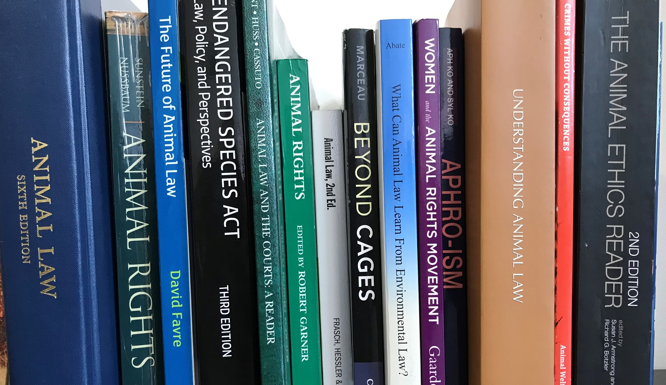
MAPP Thesis or Practice Track
THESIS TRACK
Write a significant paper in the Thesis Research Seminar I and II
This can meet the JD Advanced Writing Requirement
PRACTICE TRACK
Master’s externship, FAAC, or any environmental clinic working on an animal protection matter
Application deadline for clinics: Sunday, March 19

Slide 11
Online Classes
Asynchronous – no scheduled day & time
Assignments due each week
Two 7-week online terms each semester
2 or 3-credit classes
~15 hours of work each week

Slide 12
Externships
Minimum of 4 and max of 10 credits
Must be with an animal protection organization
Can be paid!
Cannot meet the JD experiential requirement
Network with your summer faculty!

Slide 13
Registration

Slide 14
Registration
Campus Web registration for 1Ls opens April 4
Register for summer master’s classes plus fall & spring 2L JD classes
Email registrar@vermontlaw.edu to share classes
Between now & April 4
Group advisor meeting
Anne Linehan, Eli Gleason, & Jennifer Sekula (“Team Kulahanson”) Tuesday, March 21, 3:30 pm
Also schedule one-on-one appointment as directed by your advisor

Slide 15
Final Advice
Summer syllabi are posted as we receive them from faculty at https://www.vermontlaw.edu/resources/book-lists-and-reading-assignments.
Past students can have good insights on classes & favorite professors. ALPI faculty and staff are happy to connect you.
Faculty are helpful for big picture discussions.
Best to talk to your advisor about degree requirements and to make sure you are on track to graduate.

